Slide 1
Basic information about the app and this document
App’s operating environment: Android, iPhone, iPad
UI: English default and Korean support at this moment
App’s word: English default and Korean support at this moment
Information input: world wide many local language support needed.
Electronic name card in the app needs to be generated meeting professional printing requirement(see http://www.psprint.com/helpcenter/preparing_artwork_files/index.asp )
This screen shot of the document describes just the concept for clear communication to developers, so better and detailed UI design is required and needs to be suggested for real implementation.
→ Some screen flow which can be inferred was omitted for the convenience.
The usage of server side needs to be minimized in order to protect personal information and minimize operation cost like traffic charge. If needed significantly, would like to offer users as charging service. (for example, direct music/video streaming instead of referring to music/video site link)
The app needs not to infringe on Snapdat Networks, Inc.’s US patent 8078205 B2.

Slide 2
While app is being launched, this screen pops up
The design needs to look like real business card book.
ABC card
Good bye to paper business card. From now on you can make, send and share the beautiful and convenient electronic name card.
If you are not good at designing electronic card nor satisfied with the templates, you can order the professional design service at ABC Card.

Slide 3
Address book | My Card | Incoming | Tools | Settings
User selects the category of name card and then make new cards there.
Official – for official life such as business activities
Personal – for personal life such as hobby club, etc.
Open Public – public name card which can be searched in the app even though it is not exchanged. Probably It will consist of the information which user can want many people to know.
Secret – No exchange of this card. For user only. For a kind of diary and planner.
User can make the business name card of the future. On it user can write the plan to achieve the future job.
Greetings: for greetings card
Life event: for life event-related activities
Advertising – any kind of card for advertising as charging service. This category needs to support commercial tools for activity like electronic stamping on the coupon.
Please select the type of the card for your purpose.
Official
Mainly for the business
New Card
Personal
Open Public
Mainly for friends
For mass media
New Card
New Card
Secret
Greetings
Only for me
New year, Christmas
New Card
New Card
Life Event
Advertising
Wedding, Birthday
Event coupon, Stamp coupon, etc.
New Card
New Card

Slide 4
Address book | My Card | Incoming | Tools | Settings
Please select how to make card.
New electronic card
Based on many templates, we can design nice card easily on your own.
New card based on paper card
Capture your paper card or
import your image file of the paper card. (.eps, .ai, .cdr, …)
Custom design service order
Our professional designers will make best card instead of you.
Back

Slide 5



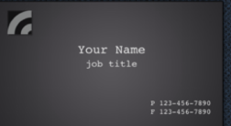


Address book | My Card | Incoming | Tools | Settings
In the category box , there will be the category list which user can select.
For example, when user selected the type of official card, there could be the list of industry.
Consulting, SW development, manufacturing, etc.
The template will have both front and back side.
The template will be located in the server side.
For uploading the template, need to have the administration web-page for uploading in the server.
In addition to free templates, there will be charging templates which users need to buy.
Please select the template
Category
Subcategory
search
Blank
Classic
XX people
XX people
Business Strict
XXX
XX people
XX people
Casual
Art School
XX people
XX people
1 2 3 4 5 6 7
Custom design service order
Back

Slide 6


Address book | My Card | Incoming | Tools | Settings
In the left side, there will be the below menu list for editing.
In the Import menu, user can import the card which he or she made and had. Based on it , he or she can edit.
Import
Background
Image(Logo, Photo,..)
Name
Title
Company/Organization
Contacts
Address/Map
QR code
Multimedia
Others - Text
Others - Clipart/Shapes
Bolder
Material/Shape
Front Back
Save & Continue
Back

Slide 7

Address book | My Card | Incoming | Tools | Settings
The screen when user selected the yellow menu
Import
Background
Image(Logo, Photo,..)
Name
Title
Company/Organization
Contacts
Address/Map
QR code
Multimedia
Others - Text
Others - Clipart/Shapes
Bolder
Material/Shape
Front Back
Camera Roll | Camera | ???
Preview and Cropping
Card screen will be updated when user will select the picture in the camera roll.
Next page to be continued

Slide 8

Address book | My Card | Incoming | Tools | Settings
Like Instagram app, there will be many filters. and there will be some effect options.
Preview and Cropping
Effects and Filters
OK
Cancel

Slide 9
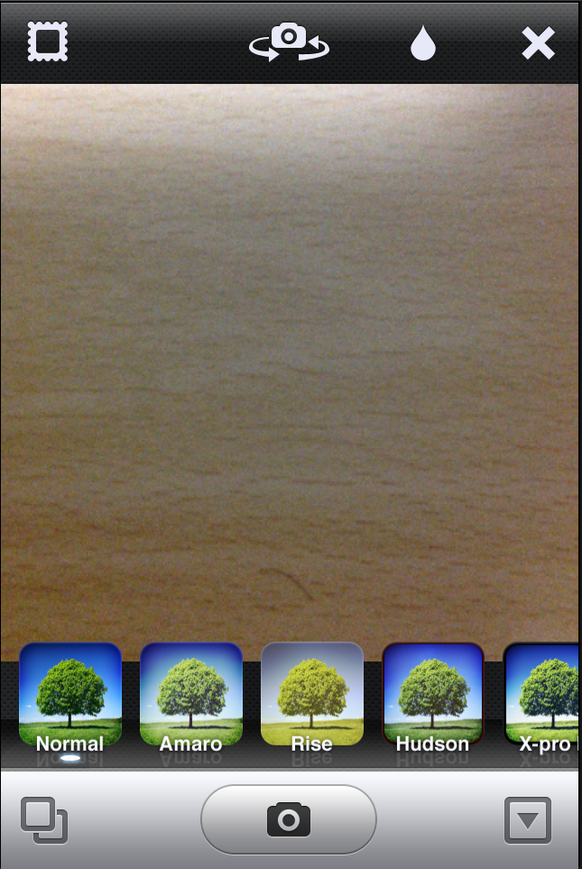
The screen when user selected the menu Camera
Similar as Instagram app

Slide 10
Address book | My Card | Incoming | Tools | Settings
The screen when user selected the yellow menu
Import
Background
Image(Logo, Photo,..)
Name
Title
Company/Organization
Contacts
Address/Map
QR code
Multimedia
Others - Text
Others - Clipart/Shapes
Bolder
Material/Shape
Front Back
Logo | Photo | Others
Camera Roll | Camera | ???
Preview and Cropping
Next page to be continued

Slide 11
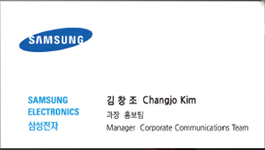
Address book | My Card | Incoming | Tools | Settings
The screen when user selected the yellow menu
Preview and Cropping
Background
Image(Logo, Photo,..)
Name
Title
Company/Organization
Contacts
Address/Map
QR code
Multimedia
Others - Text
Others - Clipart/Shapes
Bolder
Material/Shape
Effects and Filters
Add
Cancel

Slide 12
The screen when user selected the menu Camera
Similar as Instagram app

Slide 13
Address book | My Card | Incoming | Tools | Settings
The screen when user selected the yellow menu
Import
Background
Image(Logo, Photo,..)
Name
Title
Company/Organization
Contacts
Address/Map
QR code
Multimedia
Others - Text
Others - Clipart/Shapes
Bolder
Material/Shape
Front Back
Logo | Photo | Others
Camera Roll | Camera | ???
Preview and Cropping
Next page to be continued

Slide 14
Address book | My Card | Incoming | Tools | Settings
The screen when user selected the yellow menu
Preview and Cropping
Background
Image(Logo, Photo,..)
Name
Title
Company/Organization
Contacts
Address/Map
QR code
Multimedia
Others - Text
Others - Clipart/Shapes
Bolder
Material/Shape
Effects and Filters
Add
Cancel

Slide 15
The screen when user selected the menu Camera
Similar as Instagram app

Slide 16
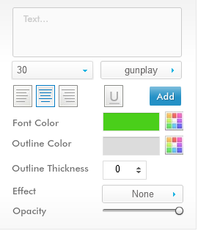
Address book | My Card | Incoming | Tools | Settings
The screen when user selected the yellow menu
Import
Background
Image(Logo, Photo,..)
Name
Title
Company/Organization
Contacts
Address/Map
QR code
Multimedia
Others - Text
Others - Clipart/Shapes
Bolder
Material/Shape
Front Back
Type name...

Slide 17
Address book | My Card | Incoming | Tools | Settings
The screen when user selected the yellow menu
Import
Background
Image(Logo, Photo,..)
Name
Title
Company/Organization
Contacts
Address/Map
QR code
Multimedia
Others - Text
Others - Clipart/Shapes
Bolder
Material/Shape
Front Back
Type title...
Title information could be located in the server. And could be auto-suggested as user types.

Slide 18
Address book | My Card | Incoming | Tools | Settings
The screen when user selected the yellow menu
Import
Background
Image(Logo, Photo,..)
Name
Title
Company/Organization
Contacts
Address/Map
QR code
Multimedia
Others - Text
Others - Clipart/Shapes
Bolder
Material/Shape
Front Back
Type Company/Organization
Company/Organization information could be located in the server. And could be auto-suggested as user types.

Slide 19
Address book | My Card | Incoming | Tools | Settings
The screen when user selected the yellow menu
Import
Background
Image(Logo, Photo,..)
Name
Title
Company/Organization
Contacts
Address/Map
QR code
Multimedia
Others - Text
Others - Clipart/Shapes
Bolder
Material/Shape
Front Back
Phone Number
Phone number
List
List will have as followings
Traditional: Work, Home, Cellular, Fax
mVOIP: Skype, Viper, ….
List

Slide 20
Address book | My Card | Incoming | Tools | Settings
The screen when user selected the yellow menu
Import
Background
Image(Logo, Photo,..)
Name
Title
Company/Organization
Contacts
Address/Map
QR code
Multimedia
Others - Text
Others - Clipart/Shapes
Bolder
Material/Shape
Front Back
Email
Email Address
List
List will have as followings
Personal, Work
List

Slide 21
Address book | My Card | Incoming | Tools | Settings
The screen when user selected the yellow menu
Import
Background
Image(Logo, Photo,..)
Name
Title
Company/Organization
Contacts
Address/Map
QR code
Multimedia
Others - Text
Others - Clipart/Shapes
Bolder
Material/Shape
Front Back
Website
Website Address
List
List will have as followings
Personal, Work
List

Slide 22
Address book | My Card | Incoming | Tools | Settings
The screen when user selected the yellow menu
Import
Background
Image(Logo, Photo,..)
Name
Title
Company/Organization
Contacts
Address/Map
QR code
Multimedia
Others - Text
Others - Clipart/Shapes
Bolder
Material/Shape
Front Back
SNS
List
ID
URL
List will have as followings
Facebook, Twitter, ???
List

Slide 23
Address book | My Card | Incoming | Tools | Settings
The screen when user selected the yellow menu
Import
Background
Image(Logo, Photo,..)
Name
Title
Company/Organization
Contacts
Address/Map
QR code
Multimedia
Others - Text
Others - Clipart/Shapes
Bolder
Material/Shape
Front Back
Address
List
Country/Region
Street Address
ZIP/Postal Code
City, State
List will have as followings
Office, Home
List

Slide 24
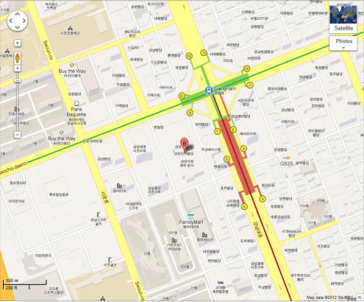
Address book | My Card | Incoming | Tools | Settings
The screen when user selected the yellow menu
Import
Background
Image(Logo, Photo,..)
Name
Title
Company/Organization
Contacts
Address/Map
QR code
Multimedia
Others - Text
Others - Clipart/Shapes
Bolder
Material/Shape
Front Back
Map
List
Typed address list or type address
The develops need to review in the viewpoint of implementation.
List will have as followings
Google Map and local map providers especially Korean portals like Naver and Daum
Add

Slide 25
Address book | My Card | Incoming | Tools | Settings
The screen when user selected the yellow menu
Import
Background
Image(Logo, Photo,..)
Name
Title
Company/Organization
Contacts
Address/Map
QR code
Multimedia
Others - Text
Others - Clipart/Shapes
Bolder
Material/Shape
Front Back
QR Code
Add
√
Name
Title
Company/Organization
Contacts
Address/Map
Multimedia
Others - Text
Expand
√
Expand
√
Expand
√
Expand
The develops need to review in the viewpoint of implementation.
In the screen there will be the information list with check box which can be included in the QR code. It is typed or need to be typed.
√
Expand
√
Expand
√
Expand

Slide 26
Address book | My Card | Incoming | Tools | Settings
The screen when user selected the yellow menu
Import
Background
Image(Logo, Photo,..)
Name
Title
Company/Organization
Contacts
Address/Map
QR code
Multimedia
Others - Text
Others - Clipart/Shapes
Bolder
Material/Shape
Front Back
Multimedia
Audio/Music | Video | Recording
Link
Type link address
Preview
The develops need to review in the viewpoint of implementation.
Upload can require sign in as charging service.
Direct upload
Browse

Slide 27
Address book | My Card | Incoming | Tools | Settings
The screen when user selected the yellow menu
Import
Background
Image(Logo, Photo,..)
Name
Title
Company/Organization
Contacts
Address/Map
QR code
Multimedia
Others - Text
Others - Clipart/Shapes
Bolder
Material/Shape
Front Back
Multimedia
Audio/Music | Video | Recording
Link
Type link address
Preview
The develops need to review in the viewpoint of implementation.
Upload can require sign in as charging service.
Direct upload
Browse

Slide 28
Address book | My Card | Incoming | Tools | Settings
The screen when user selected the yellow menu
Import
Background
Image(Logo, Photo,..)
Name
Title
Company/Organization
Contacts
Address/Map
QR code
Multimedia
Others - Text
Others - Clipart/Shapes
Bolder
Material/Shape
Front Back
Multimedia
Audio/Music | Video | Recording
The develops need to review in the viewpoint of implementation.
Recording function supports both voice recording and video recording as user’s option.

Slide 29
Address book | My Card | Incoming | Tools | Settings
The screen when user selected the yellow menu
Import
Background
Image(Logo, Photo,..)
Name
Title
Company/Organization
Contacts
Address/Map
QR code
Multimedia
Others - Text
Others - Clipart/Shapes
Bolder
Material/Shape
Front Back
Type any message or text.
..

Slide 30

Address book | My Card | Incoming | Tools | Settings
The screen when user selected the yellow menu
Import
Background
Image(Logo, Photo,..)
Name
Title
Company/Organization
Contacts
Address/Map
QR code
Multimedia
Others - Text
Others - Clipart/Shapes
Bolder
Material/Shape
Front Back
Shapes | Clipart | ????
..

Slide 31


Address book | My Card | Incoming | Tools | Settings
The screen when user selected the yellow menu
Import
Background
Image(Logo, Photo,..)
Name
Title
Company/Organization
Contacts
Address/Map
QR code
Multimedia
Others - Text
Others - Clipart/Shapes
Bolder
Material/Shape
Front Back
Shapes | Clipart | ????
Depending on the selected shapes, the adjustable features show up.

Slide 32
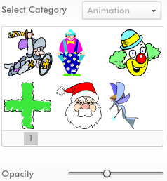
Address book | My Card | Incoming | Tools | Settings
The screen when user selected the yellow menu
Import
Background
Image(Logo, Photo,..)
Name
Title
Company/Organization
Contacts
Address/Map
QR code
Multimedia
Others - Text
Others - Clipart/Shapes
Bolder
Material/Shape
Front Back
Shapes | Clipart | ????
There will be category list for clipart.

Slide 33

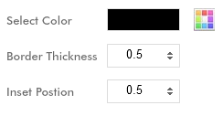
Address book | My Card | Incoming | Tools | Settings
The screen when user selected the yellow menu
Import
Background
Image(Logo, Photo,..)
Name
Title
Company/Organization
Contacts
Address/Map
QR code
Multimedia
Others - Text
Others - Clipart/Shapes
Bolder
Material/Shape
Front Back
There will be category list for clipart.

Slide 34
Address book | My Card | Incoming | Tools | Settings
The screen when user selected the yellow menu
Import
Background
Image(Logo, Photo,..)
Name
Title
Company/Organization
Contacts
Address/Map
QR code
Multimedia
Others - Text
Others - Clipart/Shapes
Bolder
Material/Shape
Front Back
Shape
Horizontal
Update
Paper Material
In shape menu, there will be horizontal or vertical.
In paper material menu, there will be many options.
Standard uncoated, Glossy heavy weight, standard coated(14pt/matte) and so on.
Standard uncoated
Update

Slide 35
Address book | My Card | Incoming | Tools | Settings
The screen when user selected the card validity.
You had the name card done.
Please set up the validity time.
Electronic card will have life span
Default setting is usage for now and setting is from none to none. If use timeline is check, date box is enabled.
Front Back
√
Usage for now
√
Use timeline
None or From
~
None or To
Future
From
To
Past
From
To

Slide 36
Address book | My Card | Incoming | Tools | Settings
When the message is sent by email, would like to have the content of email include explanation of features of ABC card in addition to it with vCard attachment.
Do you want to beam your name card to your acquaintances in the address book?
It will be sent with your messages.
Message
John Smith wants to give you the electronic name card made by ABC Card.
Type your messages...
Get the name card
with ABC Card
Explore ABC card
Get only name card

Slide 37
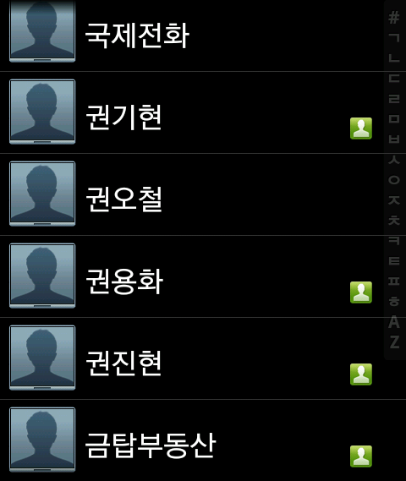
Address book | My Card | Incoming | Tools | Settings
Recipient
Depending on the available contact information which the app can send the message, many tools such as MMS, Email, Skype, Viper, Kakaotalk, Line and so on show up
Total XX persons
- MMS xx, Email XX, Skype XX, Viper XX, ..
MMS
Email
Skype
√
√
√
√
√
√
√
√
√
√
√
√
√
√
√
√
√
√
√
√
√
√
√
√
Send
Cancel

Slide 38





Landing Screen of My Card
Address book | My Card | Incoming | Tools | Settings
This is the landing screen of My card
List of my cards by category
More details are shown by flip on the card.
In this screen the follow functions are supported.
New Card
Copy Card
Send Card
Export card
Print card
Share card template free of charge or Sell
Setup email footer
Delete
There are two options: 1) Only in the user side delete card and related stuffs 2) delete the recipients’ local cards with notifications to the holders that the card owner wants to delete it.
Official
Work
Organization
Personal
Open Public
Friend
Yellow Page
Secret
Greetings
2015 My Future
2012 New Year
Life Event
Advertising
2012 Oct 24 Wedding
10% off

Slide 39


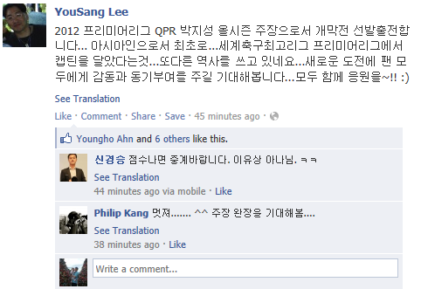
Detailed view of My Card
Address book | My Card | Incoming | Tools | Settings
In the History, there will be the history of activities related to the selected card of the user sending/editing/exchanging/sharing/updating, meeting, scheduling, conferencing, etc.
In the News Feed there will be any information which the counter-holder of selected card posted on his or her own card which the user holds in the address book.
Need to support holder view where the user can see the holders of this card.
Official
Work
History
Front Back
News Feed | Posting(2) | Messages(2) | Memo & Schedule | Tools

Slide 40

Address book | My Card | Incoming | Tools | Settings
In the Posting, the user posts the news on his or her card like the wall of facebook, which the holders of this card can see.
Official
Work
History
Front Back
News Feed | Posting(2) | Messages(2) | Memo & Schedule | Tools
Write what you want the recipients of the card
to know
Card list
Group list
Post

Slide 41
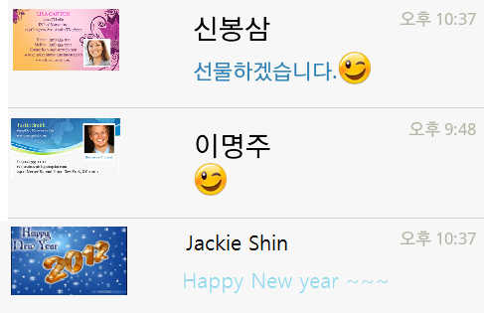
Detailed view of My Card
Address book | My Card | Incoming | Tools | Settings
In the Messages, there will be message list by contacted card
Official
Work
History
Front Back
News Feed | Posting(2) | Messages(2) | Memo & Schedule | Tools

Slide 42
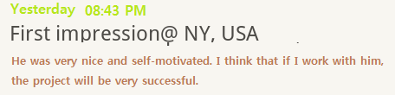
Detailed view of My Card
Address book | My Card | Incoming | Tools | Settings
In the Memo, the user write and edit his or her own memo on the card with the option that memo will be linked to selected card or user.
If user linking is opted, that memo will be shown in all my cards.
Official
Work
History
Front Back
News Feed | Posting(2) | Messages(2) | Memo & Schedule | Tools
Memo

Slide 43
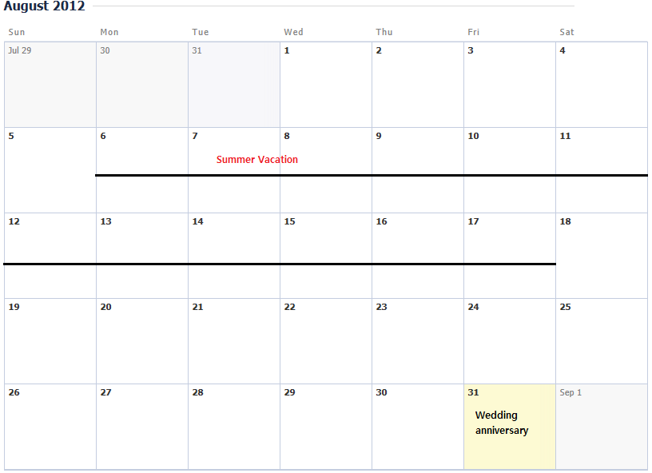
Detailed view of My Card
Address book | My Card | Incoming | Tools | Settings
In the Schedule, the user write and edit his or her schedule on the card like the Memo but there is the arrange function to ask for someone’ arrangement. There User sends MMS or whatever in order to ask. And also there is confirming function about arrangement asking.
In the Schedule user opts the exposure level of the schedule in which the card holders can see user’s schedule.
Only occupied or not, Available or not
Details of schedule
…
In the Schedule, there could be mark or notifications of life event of someone in the address book.
Official
Work
History
Front Back
News Feed | Posting(2) | Messages(2) | Memo & Schedule | Tools

Slide 44

Detailed view of My Card
Address book | My Card | Incoming | Tools | Settings
In the Tool, there is a bunch of tools which the holders of this card can see and use together.
User selects ones which will be linked to this card of available tools in Tools, which are free of charge or bought.
Official
Work
History
Front Back
News Feed | Posting(2) | Messages(2) | Memo & Schedule | Tools
Web hard
Contract Signer
...

Slide 45
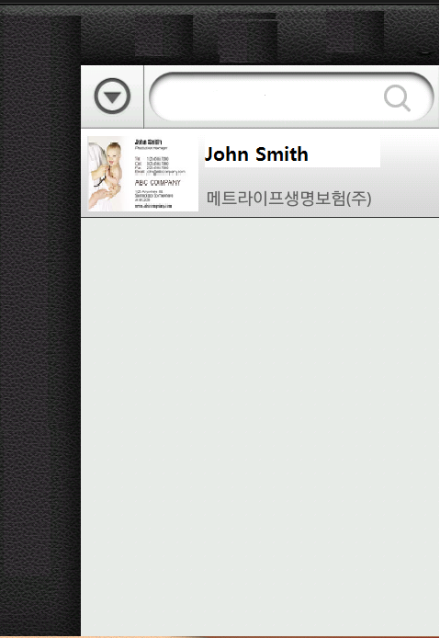

Address book | My Card | Incoming | Tools | Settings
This is the directory of both business cards you have received and contacts in the default address book.
List card in alphabetical order
List of user by category / tag / group / ABC card
Search contacts by item in the card, Search of yellow pages consisting of open public cards
Vew business card on tap of external links (Call, Website, Linkedin, Youtube, Facebook, Skype, Sound and so on) the respective app or view will be invoked (Incase of youtube video and sound a separate view within the app will be shown)
More details can also be shown on a card by flip.
Print a card.
Share or Export a business card
By MMS, Bluetooth, email, mVOIP messengers and so on.
Using default method in the default address book.
Delete a business card
New
If user taps New button the below menu pops up.
Ask for ABC card
Capture card
Select captured card from the camera roll.
Use email footer
Type information
Import contact
Would like to have * Scan card but OCR recognition engine is not ready, so later will be implemented.
All
ABC card
Non-ABC card
New
All
?
Family
?
?
Partner
?
?
?
Club
?
?
???
?
?
???
?
?
+
?
?
?

Slide 46
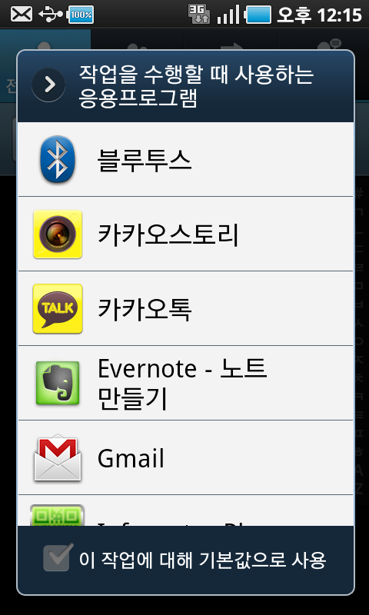
Ask for ABC card
Address book | My Card | Incoming | Tools | Settings
This is the screen when ask for ABC card is selected
In the message, the name card needs to be selected in my card list.
The screen can be replaced by the menu to choosing method as followings.
Please select the channel and fill in the recipient’s information.
√
MMS
Type ...
√
Email
Type ...
√
Skype
Type ...
√
???
Type ...
√
???
Type ...
Message
Make the name card
With ABC card
Explore ABC card
Send the contact info without ABC card
John Smith wants to get your electronic name card made by ABC card to keep in touch with you.
Type your messages...

Slide 47
Detailed view of other person’s nam ecard
Address book | My Card | Incoming | Tools | Settings
In the News there will be any information which the owner of the card posted with the option that other persons’ comment will show up ort not.
In the History, there will be the history of activities related to the selected card between the user and its owner like sending/receiving/exchanging/sharing/updating, meeting, scheduling, conferencing, etc.
History
Front Back
News | Messages(2) | Memo & Schedule | Tools

Slide 48
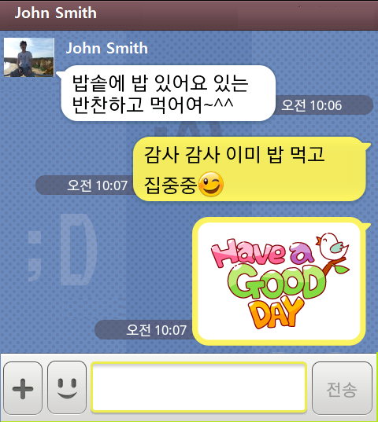
Detailed view of other person’s namecard
Address book | My Card | Incoming | Tools | Settings
In the Messages there will be chatting place with support of emoticon, file transfer and so on between the user and the card owner.
If the parties have ID in the same chatting tools like Skype, Viper, QQ, Kakaotalk, etc. could go to these tools’ chatting place.
About the Message screen, please refer to the chatting screen in the app Kakaotalk.
History
Front Back
News | Messages(2) | Memo & Schedule | Tools

Slide 49
Detailed view of other person’s namecard
Address book | My Card | Incoming | Tools | Settings
In the Memo, the memos which the user wrote about the name card will show up with the support of writing/editing function like Evernote.
The user can memo on the selected card or its owner.
User can select view type : memo matching the selected card or matching the owner of the card.
History
Front Back
News | Messages(2) | Memo & Schedule | Tools
Memo

Slide 50
Detailed view of other person’s namecard
Address book | My Card | Incoming | Tools | Settings
In the Schedule, the user can see the schedule which the owner of card posted and shared or switch to the view of my schedule related to the owner of card.
The user can ask for arrangement with the owner of the card on the other person’s schedule view or my schedule view. When user write the schedule on my scheduler, he or she can write only the description of the arrangement or ask for the arrangement in it. So my scheduler will have the status of arrangement with the flags like just plan, being asked and confirmed. This similar actions apply to the other persons’ schedule view.
The purpose of this Schedule is to help people to know each others’ schedule and arrange the meeting easily.
History
Front Back
News | Messages(2) | Memo & Schedule | Tools
Schedule

Slide 51
Address book | My Card | Incoming | Tools | Settings
In the Tools, there will be a list of tools which the owner of the card linked the card with of his or her owned tools and offered to the user.
There will be free of charge default, optional and paid tools.
History
Front Back
News | Messages(2) | Memo & Schedule | Tools
ABC card Paid Service
Web hard
Contract Signer
...

Slide 52


Address book | My Card | Incoming | Tools | Settings
This is the place where the user can see one array of advertising card, new incoming cards, news feed, messages, schedule incoming, and automated searching result of open public cards similar to the yellow pages like RSS feeder.
In the Messages, all messages will be shown with cards.
In the Schedule Incoming, the transaction about Schedule will show up.
For example, there will be the sentence like that BrightStone confirmed the arrangement of meeting 9/7 3:00 PM ~ 5:00PM.
New Card
Take
Take
John Smith
Nice to meet you. Please accept…
Take
Reject
Later
John Smith
Nice to meet you. Please accept…
Take
Reject
Later
News Feed | Messages(2) | Schedule Incoming
More
More
More

Slide 53
Address book | My Card | Incoming | Tools | Settings
In the section of New Yellow Page of Interest, there will be huge cards which many users uploaded on the open public.
By set keyword, there will be a few picked ones of the cards matched with it in the open public category.
New yellow page of interest
Setting keyword
Music Festival on Sep. 1st
K-Pop groups ….
More
Music Festival on Sep. 1st
K-Pop groups ….
More
Music Festival on Sep. 1st
K-Pop groups ….
More
Browsing More

Slide 54
Address book | My Card | Incoming | Tools | Settings
In the Tools directory, there will be huge application tools to help p2p-based business/commerce transaction based on the name card.
Eventually I target this app is a kind of default address book regardless of any platform in the world-wide, which can be synchronized with many potential tool apps. So I would like to have standard API for 3rd parties to be synchronized with ABC card like Zoho.
In phase 1, would like to focus on essential tools.
Memo, Calendar Scheduler
personal calendar and open calendar matching the card which the recipient can see.
Meeting minutes
ABC card paid service
Track order service status about ABC card
Cancel order and so on
Inquiry
Expense Tracker
Relationship statistics
How much time spent for someone, How much money spent, How much communication period,..
Ranking by expenses, call time and so on.
In phase2, would like to focus on more commercial tools
Invoice, Payment, Document Signing, Project, Escrow, Certification, Recruit and so on
Later ITECG and me will work together in the long term basis.
Detailed about each app in the Tools directory needs to be suggested by ITECG.
Free of charge and default
Memo
Scheduler
Transaction History
My Card Statistics
ABC card paid service
Cloud back up
Paper Card Printing
Design Service
Payment & Tracking
Escrow Service
Optional and Paid
Web hard
Contract Signer
...
Advertising Card Uploader

Slide 55
Address book | My Card | Incoming | Tools | Settings
Details about Settings need to be suggested by ITECG considering configurable information.
Password lock for security
Function to prevent private information leak in case of loss of cellular phone like typical locker
About Sign up
Automatic update of change name card in the side of recipient side or not
And so on

Slide 56
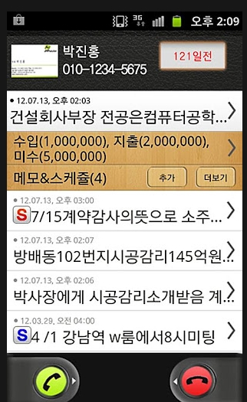
Calling or Receiving Screen
As the benchmark of competitor app, it would be nice if the user can see details of the opposite party saved in the address book when he or she call or receive the call.

Slide 57
- The End -

